Slide 1
Project Title: Disposal of Disused Materials in Rumuahia
Charter Template
Business Case/objectives:
There are scrap items and dilapidated structures in Rumuahia EPC and Oguta Gas Plant which have become hideout for reptiles thereby constituting HSSE hazard. Revenue could be generated through the sales of these items. However useful materials could be refurbished and put into usage in the asset. This project aims at recovering value through the sales of identified items.
Objective:
Generation of revenue for the joint venture by the sale of these disused materials via a tendering process to the host community.
Potential Benefits & Measurement:
circa N2mln
Project Scope/Actions :
Compile list of materials to be written off and disposed
Obtain asset approval
Liaise with CP investment and recovery team for template population
Obtain NAPIMS approval since value is >N100,000
Group materials into lots
Invitation to tender by host community vendors
Site preparation (de-roofing, minor civil works, logistics request for lifting)
Movement of materials out of Rumuahia.
Critical Success Factors:
Constant follow up with CP investment recovery team
Civil maintenance contract for minor works
Logistics request
High-level Timeline:
L0-L1: September 2018
L2: October 2018
L3: December 2018
L4: February 2019
L5: March 2019
Initiative End
Project Sponsor: Aniemeke Samuel
/ Wilcox Emmanuel
Implementation Lead: Digbani Tamunofiri/ Darlinton Opara
Project Team:
Adedoyin A/Amadi James (Asset)
Lazarus Enwereuzor (CP inv. Recovery)
Chika Nnadi (CP inv. Recovery)
Okpeze Tina (HSSE)

Slide 2
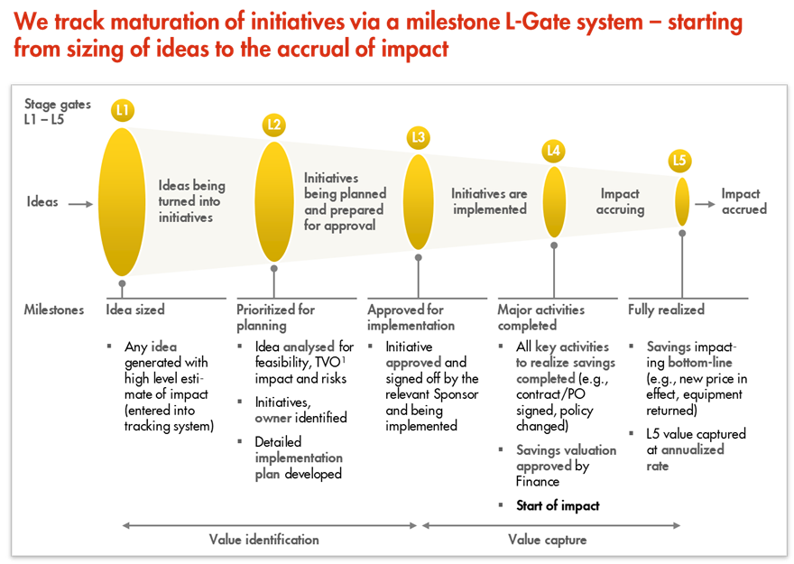
L1 – L5 Gates

